Slide 1


Navigating the current political landscape
Policy Working Group
RREUSE Members’ Meeting
(The Hague, 17 October 2024)
Groupe Terre asbl

Slide 2

Session Outline
11:30 - 11:40 Introduction and situation at the EU level
11:40 - 11:50 National-level advocacy mapping
11:50 - 12:20 Discussion round 1: Breakout groups
12:20 - 12:35 Recap of the mapping and discussion round 1
12:35 - 13:00 Discussion round 2: All PWG participants

Slide 3
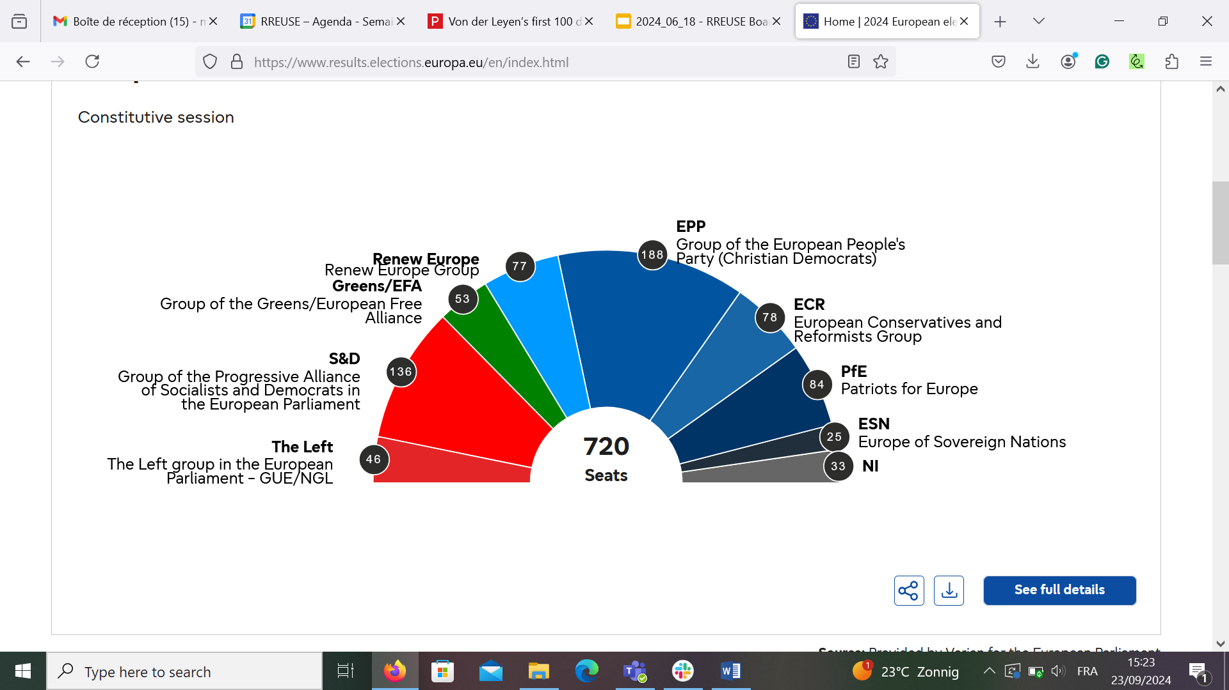
2024 - 2029 EU Parliament

Slide 4
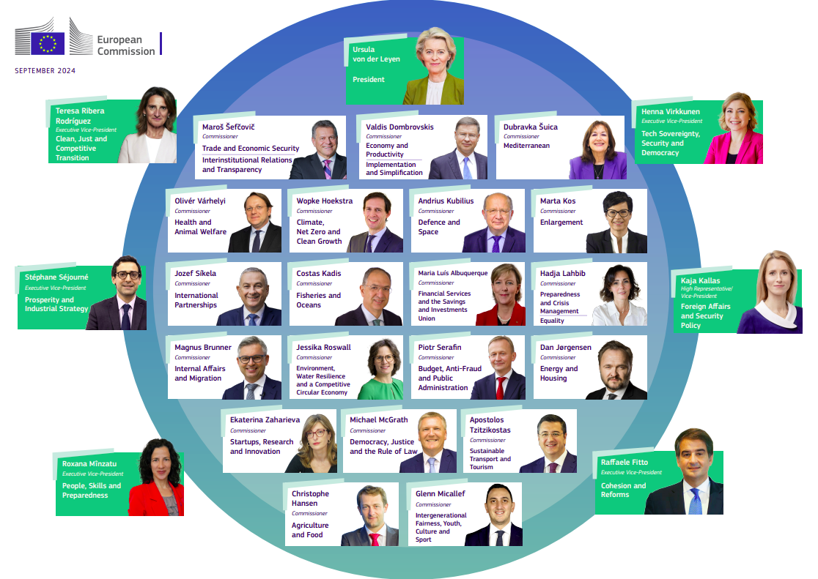
Proposed College of Commissioners

Slide 5

Announced policies
Circular Economy Act to create a single market for waste.
2025 Action Plan on the Pillar of Social Rights (incl. Social Economy Action Plan).
2014 EU Public Procurement Directive revision.
Union of Skills to foster basic skills, recognition, VET
State Aid Framework to simplify rules and for social housing.
European net zero infrastructure incl. for the circular economy.
Clean Industrial Deal incl. to incentivise investments and decarbonisation.

Slide 6
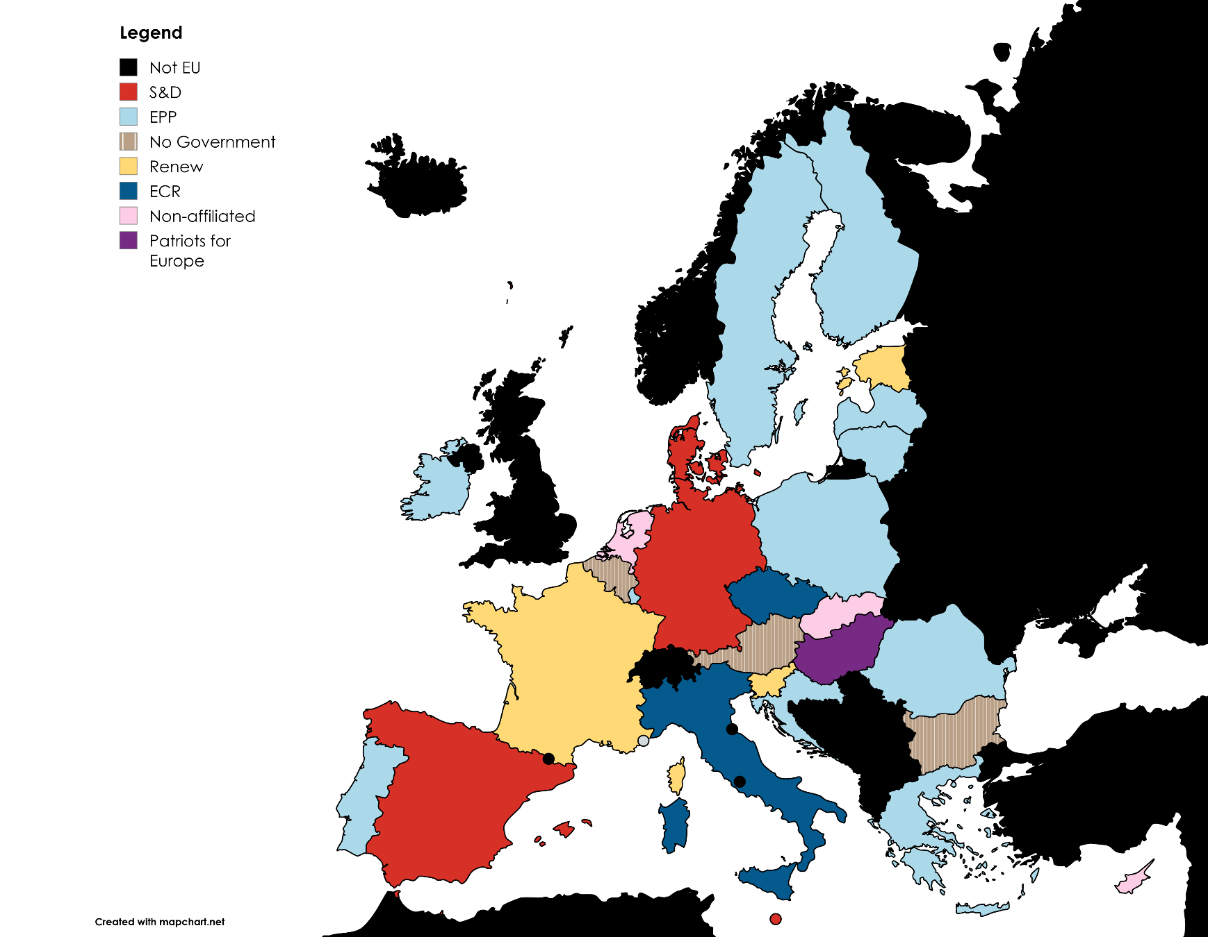
Council
as of
3 Oct.

Slide 7
Discussion points (1)
Have you perceived any changes in your recent interactions with national policymakers that could be due to the changing political circumstances?
How do the announced EU Commission’s policy priorities compare to those of your national government?
Have you already adapted or are you planning to adapt your advocacy strategy vis-a-vis your government based on the changing political circumstances? If so, how?

Slide 8
Discussion points (2)
What are your views on engaging with far-right politicians?
What should be our advocacy strategy and tactics at the EU and national level?
How can the RREUSE secretariat and members best support our respective advocacy efforts in the changing political landscape?

Slide 9





Thank you and keep in touch
RREUSE
edoardo.bodo@rreuse.org
marie-jeanne.gartner@rreuse.org
neva.nahtigal@rreuse.org
simone.schirru@rreuse.org
RREUSE_Brussels
RREUSE.RREUSE
RREUSE_Brussels

