Slide 1
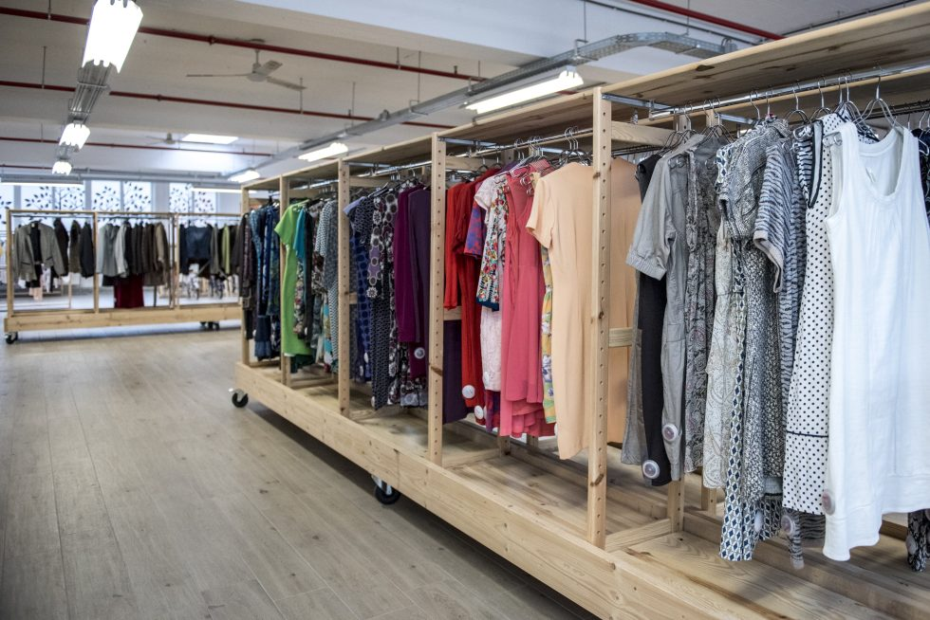
Policy Working Group
08.04.2025
De Kringwinkel
Notes:
Please, don’t edit this document. Instead, make an copy.

Slide 2
Session Outline
Circular Economy Act & EPR position papers
Analysis Waste Framework Directive
Textile crisis next steps

Slide 3
Circular Economy Act position paper

Slide 4
CEA’s aim
Enable the free movement of circular products, secondary raw materials and waste
Foster a higher supply of high-quality recyclates
Stimulate demand for secondary materials and circular products
Bring down feedstock costs
→ focus on recycling
→ lack of ambition on reuse and repair

Slide 5
CEA’s announced measures
Revise and simplify existing rules on e-waste (focus on recovering CRM contained in WEEE)
Harmonise “end of waste” definitions
Simplify, digitalise and expand EPR
Review the VAT Directive rules on the second-hand scheme

Slide 7
CEA - Key asks
1. Quantitative waste prevention and preparing for reuse targets
2. SE recognised and involved as key actors in waste collection under EPR schemes
3. Financial incentives
4. EPR fees distribution in support of the waste hierarchy
5. Tax reductions to support the waste hierarchy
6. Mandatory green and social public procurement
7. Extended ban on the destruction of unsold goods

Slide 8
CEA key asks
Any red flags?
Any major aspect missing?

Slide 9
EPR key asks

Slide 10
EPR funding
Full cost coverage of SE activities
Earmarked funding for SE
"Necessary cost" concept not to disadvantage SE

Slide 11
Prioritise waste hierarchy and support for SE
EPR funding aligned with the waste hierarchy
Mandatory waste prevention and management targets
Ensured SE access to quality waste streams
Maintain SE ownership of collected goods

Slide 12
PRO governance
Inclusive governance
Prevent race to the bottom among PROs
Ensure producer responsibility across borders

Slide 13
Eco-modulation
Eco-modulation based on overproduction practices
Ensure full cost-coverage independently from eco-modulation
New mandatory EPR
Mandatory EPR schemes for furniture

Slide 14
Any red flags?
Any major aspect missing?

Slide 15
Analysis Waste Framework Directive

Slide 16
Legislative status
February 18: provisional agreement reached by the EU Parliament and Council of the EU
March 18: ENVI Committee approved the agreement
July 7: plenary vote
Council approval: most likely after summer
Final agreement can be found here

Slide 17
Enforcement timeline
Transposition: 20 months
EPR implementation: 30 months
After entry into force of the directive

Slide 18
General principles
Member States are mandated to introduce EPR schemes for textiles
Member States may set up EPR schemes for mattresses
Producers need to appoint a PRO to assume the producer responsibility on their behalf
PRO must establish a separate collection system
Possibility to have a monopolistic or a competing model for PRO but Member States are encouraged to consider multiple PRO system

Slide 19
General principles
Concept of necessary cost: cost coverage should not exceed the costs necessary to provide service in a cost-efficient way
All textiles considered waste upon collection
Exception: textiles directly handed over by end users and directly professionally assessed as fit for reuse at the collection point by the reuse operator or social economy entities, shall not be considered waste upon collection

Slide 20
Good
Specific provisions for social economy entities (SEE) safeguarded
Social economy & social enterprises mentioned 33 times (compared to 3 mentions in 2018 revision)

Slide 21
Good
EPR schemes should maintain and support the activities of social economy entities
PRO are not allowed to refuse the participation of SEE
SEE allowed to maintain and operate their own separate collection points
Equal or preferential treatment in the location of the collection points for SEE
SEE not required to hand over textile collected to the PRO
Member States will be able to link EPR fee levels to companies’ harmful commercial practices powering fast and ultra-fast fashion

Slide 22
Mixed feelings
Reporting obligations for SEE operating their own separate collection points:
Must submit at least each year information the quantity by weight of the separately collected used and waste textile
Can be exempted by Member State if it creates a disproportionate burden
Progress on inclusive governance but remains vague:
Member States shall ensure that relevant actors, including social enterprises, are involved in the implementation of the extended producer responsibility scheme

Slide 23
Bad
In the future evaluation of the Directive (2029), the Commission will look into the possibility of requiring a financial contribution from commercial reuse operators, in particular larger ones.
No waste prevention/management targets (pushed back to the evaluation).
No mention of permit requirements for the collection
Lengthy timeline aggravating the funding gap

Slide 24
Textile crisis

Slide 25
Next strategic steps
Push European Commission to encourage Member States to unlock funding for the sector
Coordinate a parliamentary question
Need a wide range of political groups
Funding gap table
To be shared as aggregate data

Slide 26
Questions for members
Developments at national level?
Parliamentary question
→ Do you have any contact with MEPs from different political groups we can engage with?
Funding gap table
→ How can we best use this data?

Slide 27
Thank you and keep in touch
RREUSE
marie-jeanne.gartner@rreuse.org
simone.schirru@rreuse.org
RREUSE_Brussels
RREUSE.RREUSE
RREUSE_Brussels

